Slide 1
NETFLIX – Explanatory Data Analysis.
Presented By:
Sana Jalgaonkar
November Batch 02.
Video Explanation ,Click here.

Slide 2
Agenda
01. Introduction
02. Problem Statements & Dashboard
Topic discussion, source Of Dataset, fields , overview of dataset and problem statement.
The analyzed statements and snapshot of Dashboard
03. Results from analysis
04. Closing
05. Thankyou Note
The Dashboard, Charts Based on the problem statement.
A quick summary and conclusion.

Slide 3

Introduction
.With a company valuation of over $164 billion, Netflix has surpassed Disney as the most valued media company in the world. What is the secret to their success? Big data and analytics.
Netflix use data analytics by collecting data from their 151 million subscribers, and implementing data analytics models to discover customer behaviour and buying patterns.
I tried representing here one of those analysis done on excel on Netflix’s dataset taken by Kaggle.

Slide 4
Analysis Problem Statements.
What is the Count of show_id based on provided ratings ?
What is the sum of release-year based on types ?
What are the types in Dataset?
How is the Production of Movies and Shows over years?
Which ratings are trending/popular these days?
Which genre has highest sum release years?
Which genre is famous among audience?
Which countries had highest number of releases?
Where most of the types were listed in?
Which ratings has higher number of releases?

Slide 5

Dashboard

Slide 6
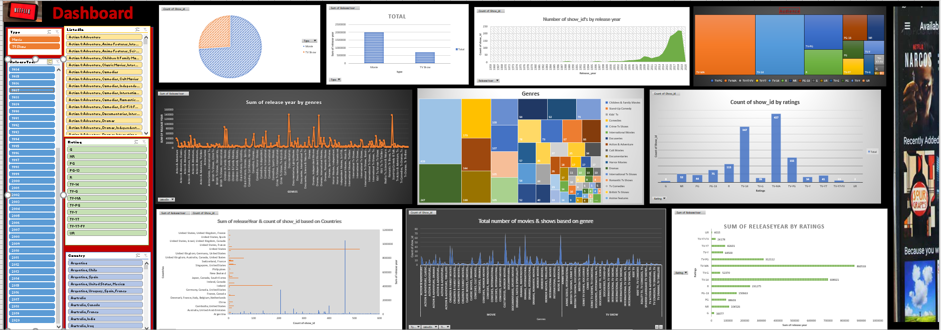

Slide 7


Slide 8
What is the Count of show_id based on provided ratings
TV—MA has the highest count of Show ID's among all ratings.

Slide 9
What is the sum of release-year based on types?
Movies type has higher sum of release year as compared to TV Show types

Slide 10
What are the types in Dataset?
Movies
TV Shows
There are more movies than TV Shows

Slide 11
How is the Production of Movies and Shows over years?
Over the years, we can see the productions and release of both the types has increased vastly.

Slide 12
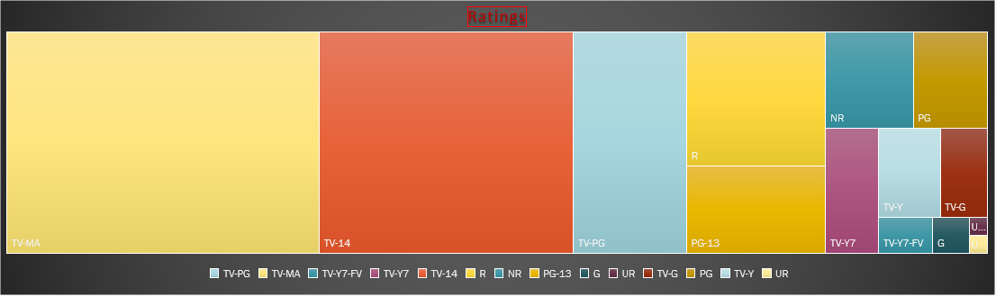
Which ratings are trending/popular these days?
Types with ratings - TV-MA followed by TV-14,TV-PG and R can be said are quite famous among audiences.

Slide 13
Which genre has highest sum releaseyear?

Slide 14
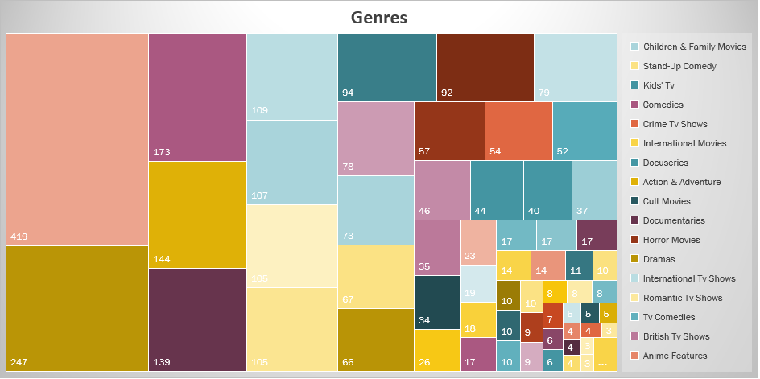
Which genre is famous among audience?

Slide 15
Which countries had highest number of releases?
United States has releases with total number of 521 types of movies & shows released.

Slide 16
Where most of the types were listed in?

Slide 17
Which ratings has higher number of releases?

Slide 18
Summary
The two main types are MOVIES and TV SHOWS in dataset
Netflix has more number of movies rather than shows in provided dataset.
Over the years the releases were fantastic then the previous ones.
Most of the types are rated as TV-MA.
Most among the audience prefer Dramas and Anime Genre.
United States has highest number of releases.

Slide 19

Thank you
Thanks to Akhil Thimmaiah Sir for helping us to understand the sessions of Excel and I can’t wait for what’s to come in this course.
.I would like your feedbacks for further improvements.
Reach me at:
Sanajalgaonkar2810.sj@gmail.com

